Slide 1
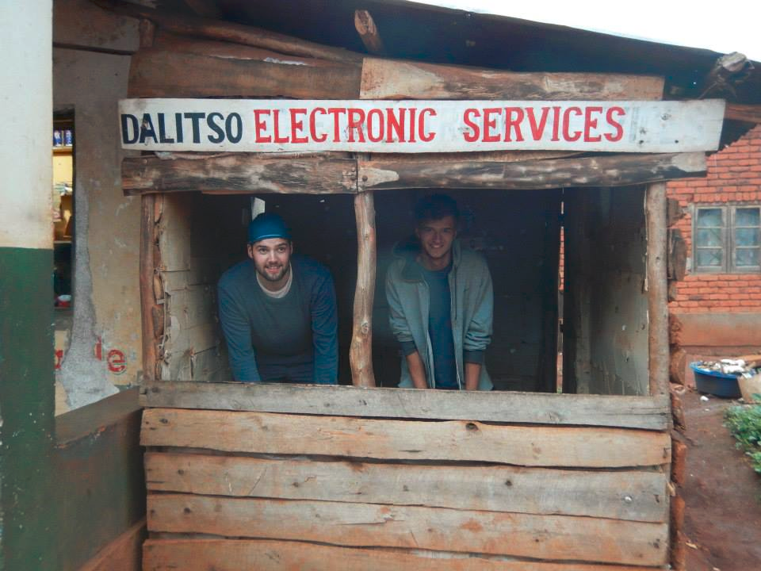
Muzungos In Africa
Kris Ellis and Max Sanderson

Slide 2
Route

Slide 3
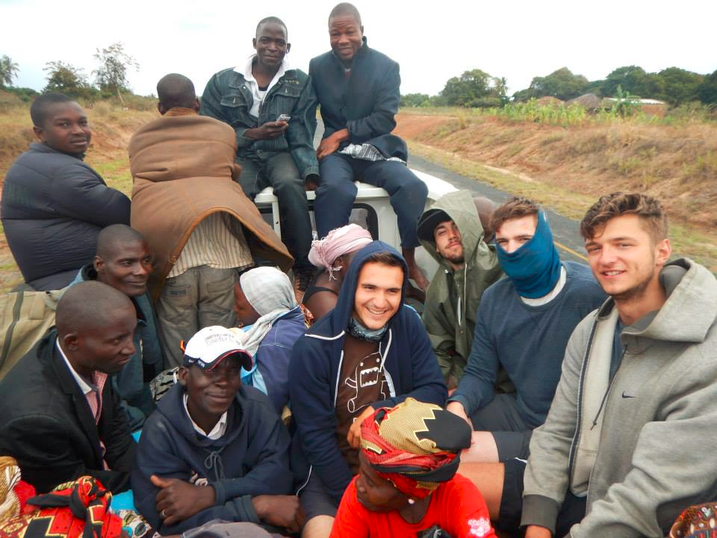
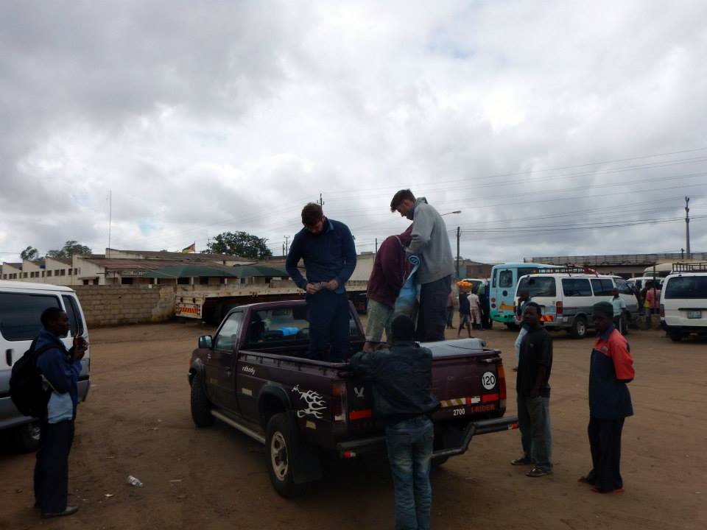
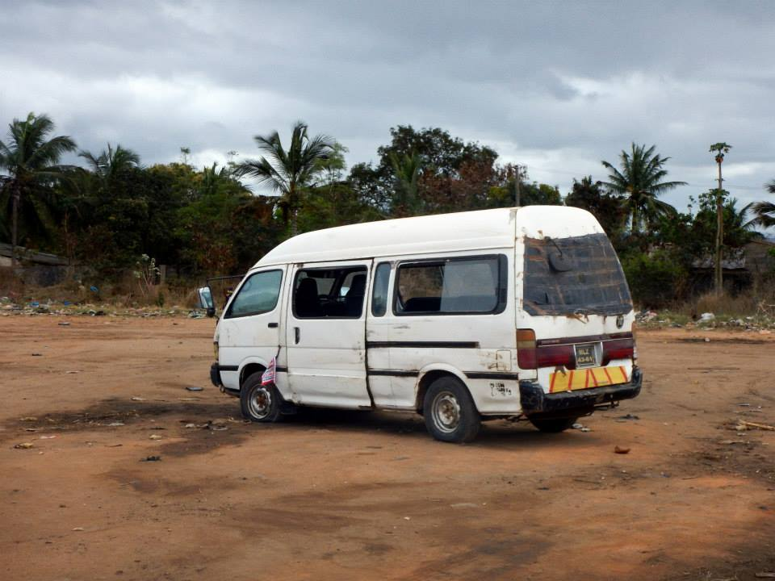
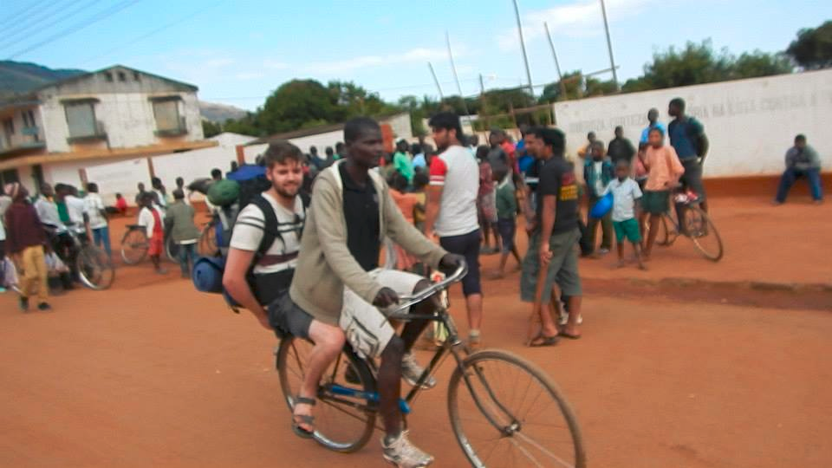
Transport

Slide 4
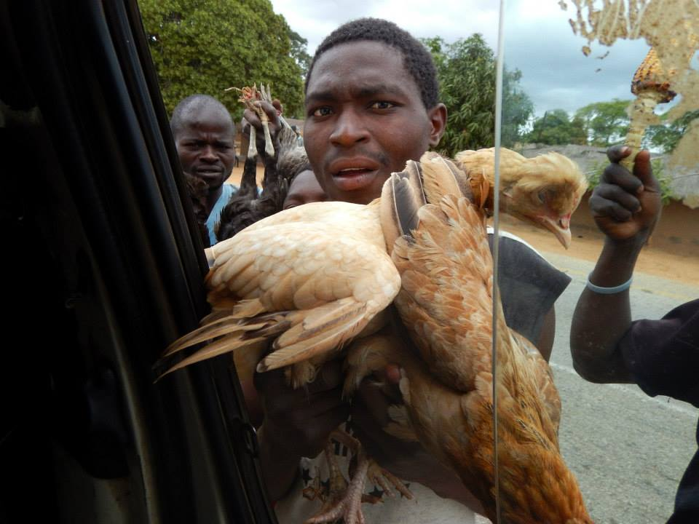
Culture – How much does a chicken cost?
Language
Portugese, Chichewa, English
Currency
Metical, kwacha
Food
Zima
Famine
Malawi - 2002

Slide 5
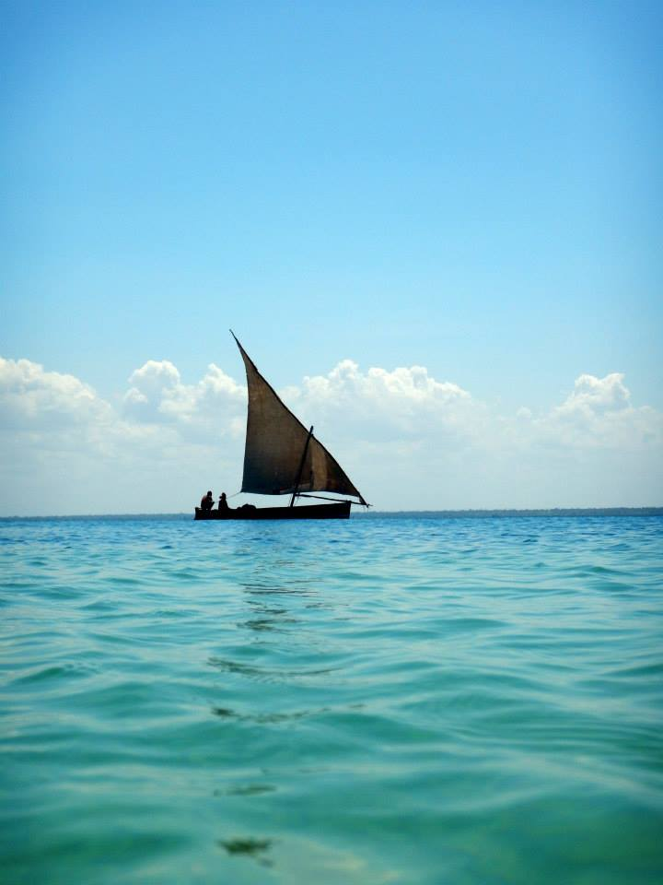
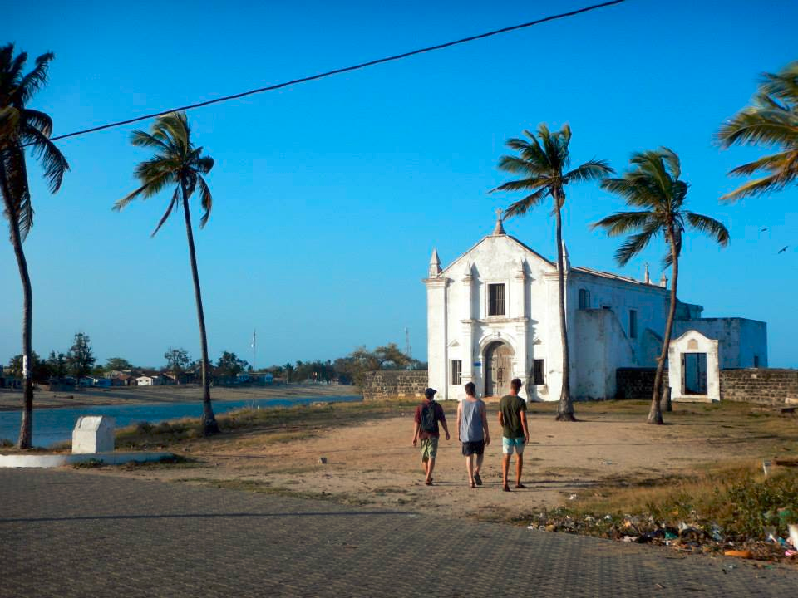
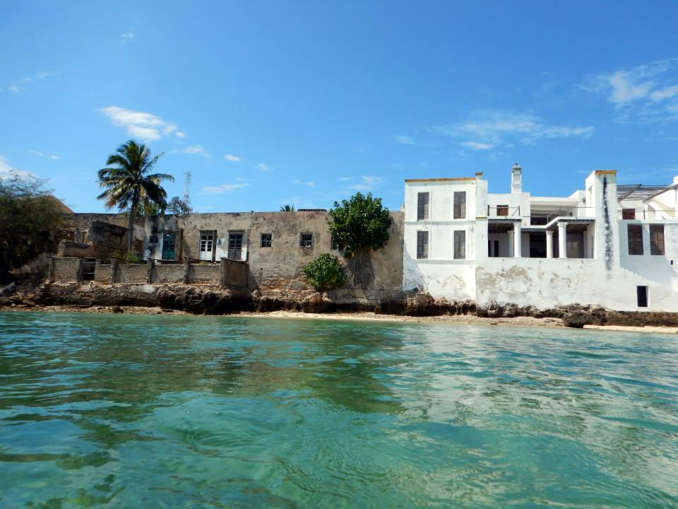
Mozambique Island
Oldest European building in the southern hemisphere 1522
Major Arabic trading outpost
A cultural melting pot

Slide 6
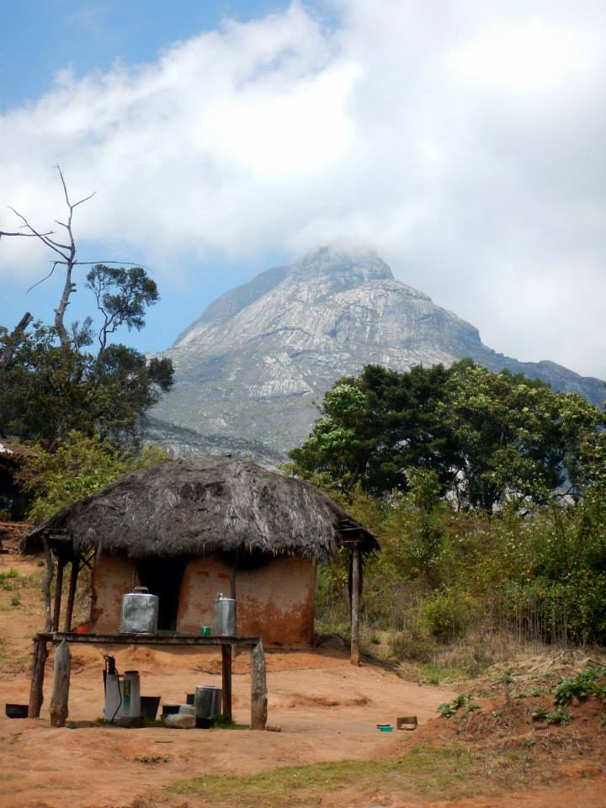
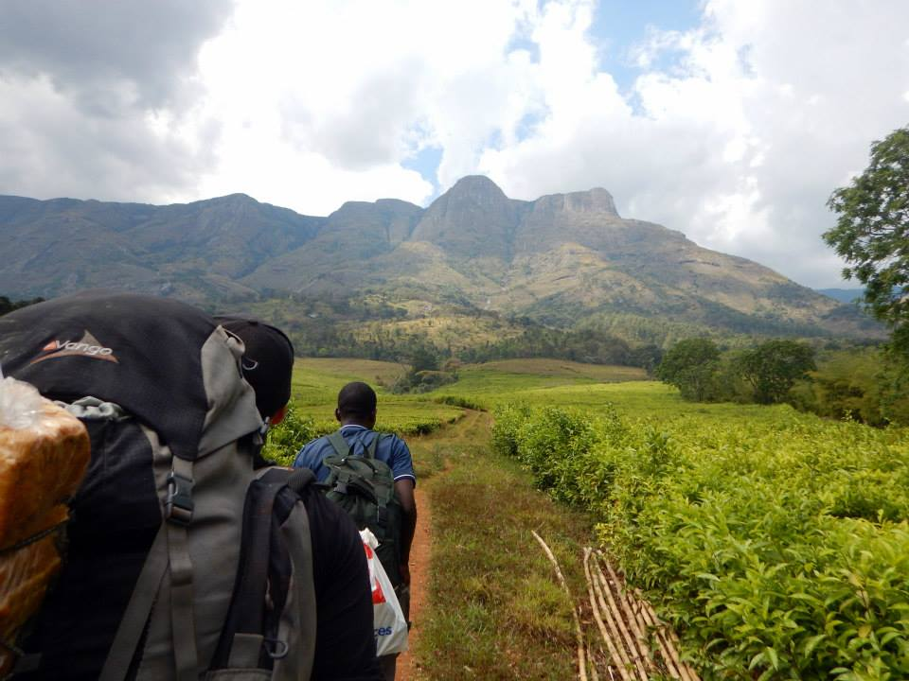
Mount Mulanje
3000m Peak
Inspired the hobbit
Surrounded by tea plantations

Slide 7
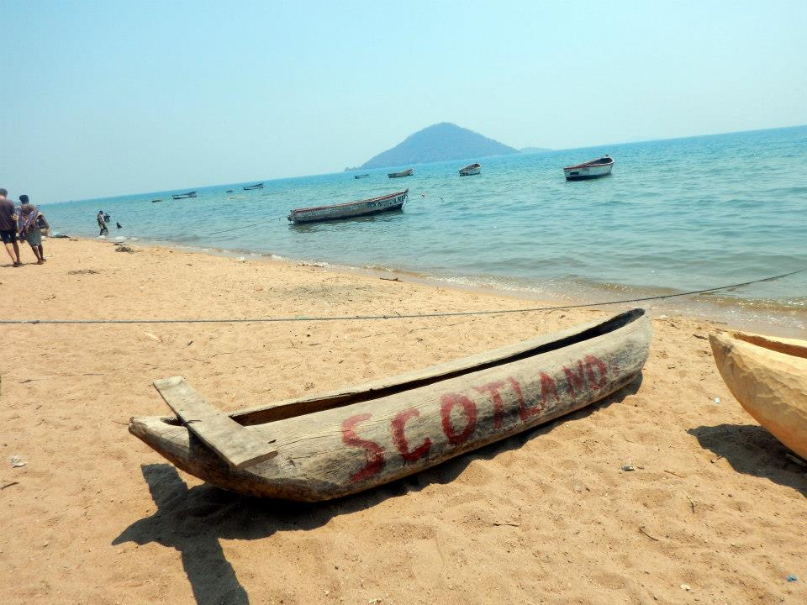
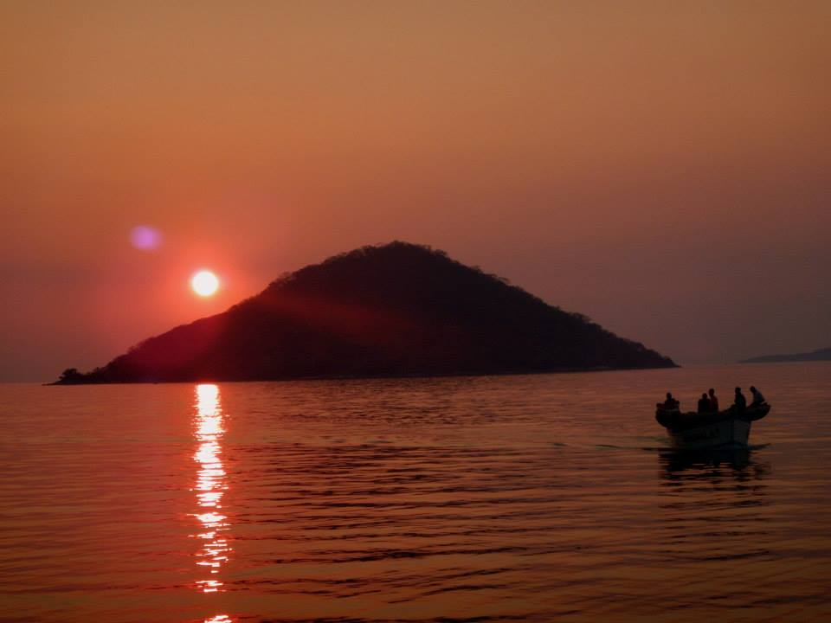
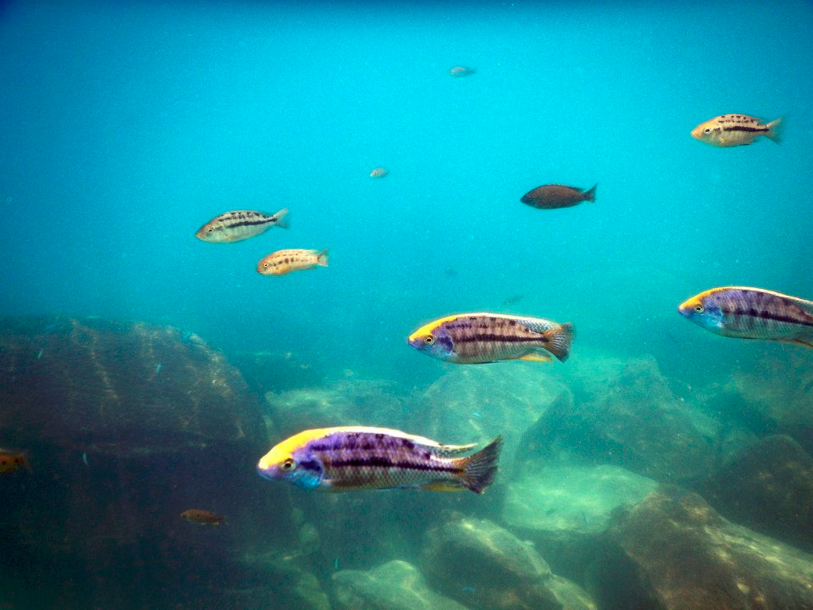
Lake Malawi

Slide 8
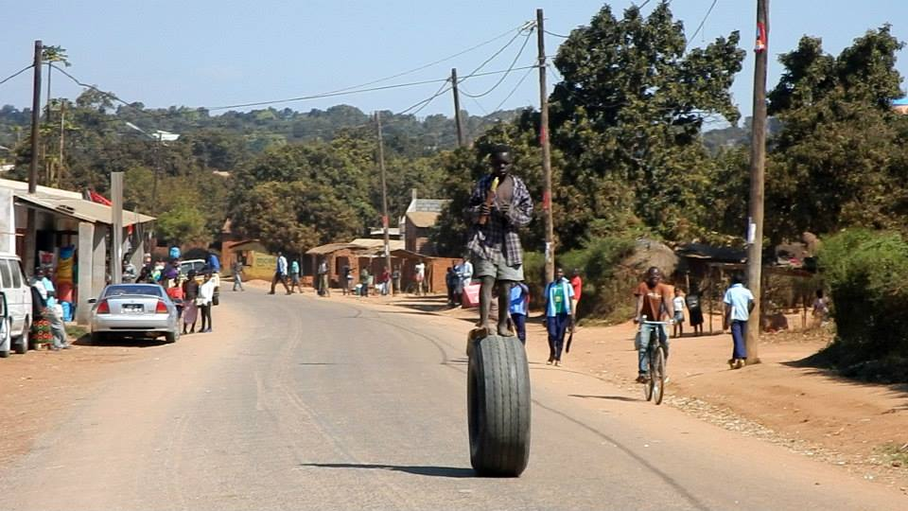
Thank You! Any Questions?

